Slide 1

Solving farmers queries using chatbot

Slide 2


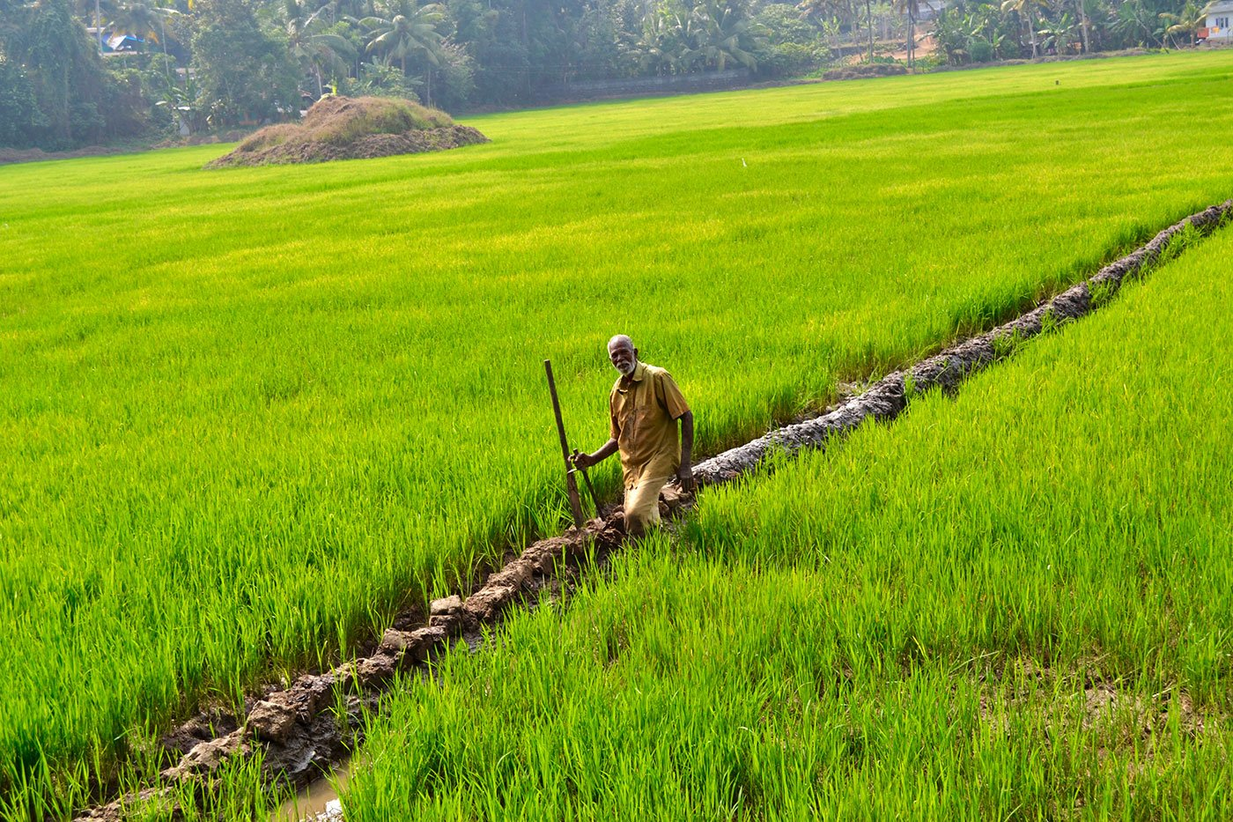
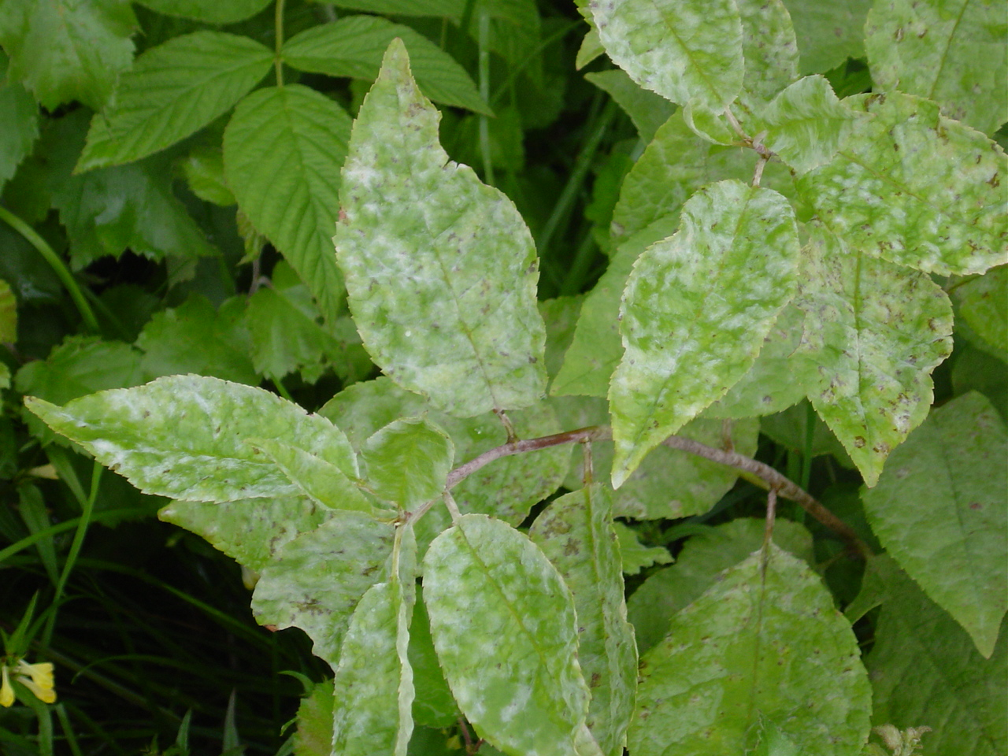
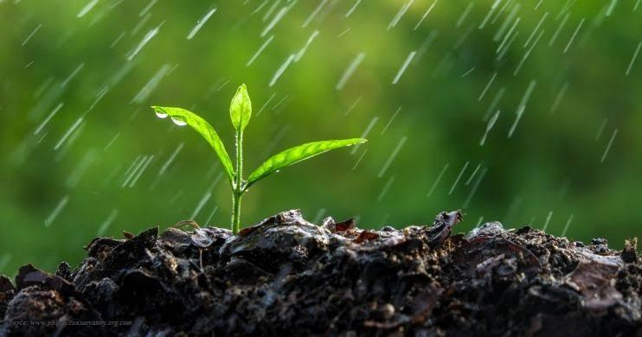
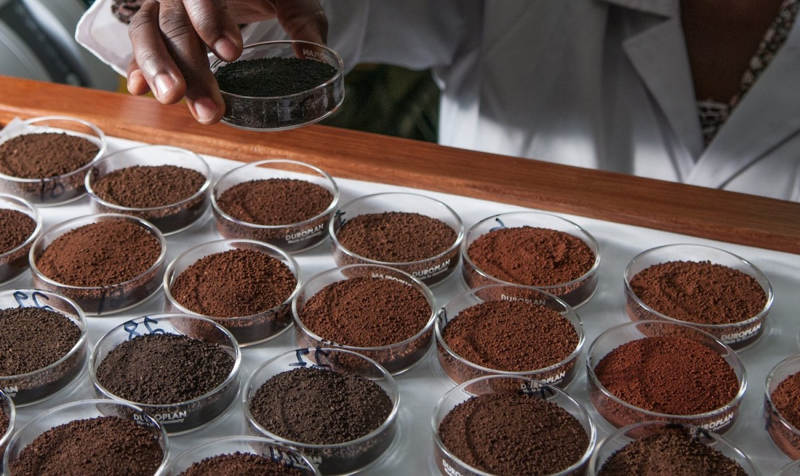
This farmer knows only one language
Field officer
Crops
Diseases
Crop rotation
Soil fertility

Slide 3
Introduction
We would like to built a chatbot for farmers to resolve different queries related to agriculture with in a short time and to assist farmers in different situations to get better agriculture production and give plenty of information about agriculture thorough this chatbot.
There are many problems faced by farmers due to lack of information available to the so we will assist then through chatbot in following fields.

Slide 4
Crop rotation
Crop rotation is the best practice to increase production for different agriculture products because when we grow one crop it takes all the minerals required so soil loses those minerals. At that point after harvesting we need to grow another crop which requires minerals other than previous crop mineral and gives the minerals that are taken by the previous crop to the soil. As this information is crucial we are making this easily available to the farmer.

Slide 5
Languages & Crops
As all we know that many of the Indians don’t have good knowledge in English so we will try to make this chatbot available in minimum of three languages which are Telugu, Hindi, English we can give info both in text and voice with these languages.
Whenever the farmers try to know the complete knowledge about certain crop they are not able to get that in a single platform so we are making that possible by giving plenty of information whenever farmers asked for details of certain crops.

Slide 6
Industries nearby and schemes
Some of farmers don’t know about the industries near to them and they plan to cultivate other crops which product has to be taken to factory which is far to them so we will assist him in way that whatever factory is near to him so that they can produce product required to that factory and can easily take that to factory after harvest. Mainly farmers don’t have knowledge about the schemes offered by government and other private organisations if they know about certain schemes they will be benefitted so we will provide complete information of schemes available to them.

Slide 7
Diseases & Details of agricultural officers
After the plantation due to lot of bacteria and insects crops may damage then if farmer interacts with chatbot it will suggest certain things to get out of the diseases.
Most of the farmers might not be knowing about their agricultural officer so we will provide complete details regarding officers in agriculture with contact information.

Slide 8
Soil fertility
Now a days everyone is so planned unlike in olden days so farmers are asking for the crops suitable for certain soil and information about soil testing and the complete details of the crop suitable for that soil so we are providing them the information.

Slide 9
Thank you

